Slide 1
Software Product Management Risk assessment
Nandagopal Govindan

Slide 2
Contents
Value risk
Usability risk
Feasibility risk (technical feasibility)
Business viability risk

Slide 3
Introduction
Key risks to be assessed are:
Will the customer buy this, or choose to use it? (Value risk)
Can the user figure out how to use it? (Usability risk)
Can we build it? (Feasibility risk)
Does this solution work for our business? (Business viability risk)

Slide 4
Test value
Good product teams spend most of their time on creating value. If the value is there, we can fix everything else.
If value is not there, then it does not matter how good our usability, reliability, or performance is.
Just because someone can use our product doesn't mean they will choose to use our product.

Slide 5
Test value
Identify 6 customers who truly feel the pain and are near desperate for the solution we plan to build, who are willing to test the product and buy it once ready and willing to be reference.
If you are unable to find even 4 or 5, then we are probably chasing a problem that is not very important.
It is important to explain that you are trying to build a product useful to many customers and not a custom solution.
Explain that you will dive deep into the problem and build a single solution that works well for all 6 customers.

Slide 6
Test Value
2 types of testing value
Qualitative
Quantitative

Slide 7
Qualitative testing
Qualitative testing is focused on the response, or reaction:
Do customers love this?
Will they pay for it?
Will users choose to use this?
And most important, if not, why not?
Are they willing to recommend?
Are they willing to spend significant time to work with you to develop the product
Any other?

Slide 8
Quantitative testing
Techniques to do quantitative testing:
Landing page technique (also called Fake door)
Crowd funding technique
A/B testing for features
Use pre-selected / agreed customers who have agreed to be partners / to discover the product – how many of those want it
Any other?

Slide 9
Test Usability: How?
Get sample users to test. Tell them it is just a prototype of an early product idea, request for honest feedback
See if they can tell from the landing page what the product is meant for
Observe if users can easily do the tasks
Identify places where the model presented by the software (design model) does not match with how the user is thinking (mental model)
For example, a user clicked on a button and you are not sure why he did it (these need to be fixed in next iteration)
Wrap up by asking:
Which features were valuable? (value)
How easy to use was the product? (usability)
How likely are you to buy the product? (value)
Experience sharing….

Slide 10
Test feasibility
(Technical feasibility)
This is needed when we need to use new technologies like AI / ML, Robotics, Augmented reality
Getting the engineer's perspective earlier also tends to improve the solution itself, and it's critical for shared learning
Example: There can be multiple ways to solve the problem of preventing leakage of confidential company data
Check when data is being sent out: High on safety, low on performance, low on deployment
Check after data is being sent out: Low on safety, High on performance, high on deployment
Which solution is better is for the business to decide
Experience sharing…

Slide 11
Test business viability
Business aspects to be considered:
Marketing
Sales
Customer service
Finance
Legal

Slide 12
Marketing
Your product must fit within the brand (image) promise of your company's other offerings.
HSBC PayMe Moble app example:
HSBC bank is known for high quality customer service.
They planned to introduce a Mobile app PayMe which should have highest quality of UX, performance and security.
It can not have afford to have a login feature, where the user logins with Facebook user id / password or Google user id / password, even though this may be good enough.
The perception created will be that the bank is compromising on security by depending on external entities such as Facebook

Slide 13
Marketing…
Your product must fit within the brand (image) promise of your company's other offerings.
IBM Mainframe example:
IBM is known for highly reliable products and high customer service.
Once a customer’s mainframe crashed
An engineer flew from Bombay to Delhi with a small part to fix a mainframe, because it was mission critical for the org.
If the new product idea is not backed up by a solid customer support plan, it will not fit in the brand promise of IBM

Slide 14
Sales
Do the sales people / channels have the skills to sell the product?
Our sales people may be familiar with selling business oriented products such as Payroll, Customer support or Expense process.
Now if we are introducing a tech oriented product for detecting autism using AI that analyses videos of patients who have autism (CogniAble), then the sales staff may not have the skills to handle this product and we need to have a plan to address this.
If we are used to sell product a B2C via channel partners and now we are planning to do direct sales because it is a B2B product, then our sales people may not be able to handle this.

Slide 15
Customer service
Do we need a high touch customer service model or low touch?
Twilio offers simple API such as: Dial, Play, Disconnect
Open API of banks: This may require a high level of support since it involves money

Slide 16
Finance
The costs to produce, market and sell your product must be sufficiently less than the revenue your product generates. What is the RoI, break even?
Let us say we are going to spend 100 on building, marketing and selling and recurring operational costs are negligible (hypothetical)
If the cost of the product is 1 and sales per month is 2 copy, then it will take 4 years to recover the cost. The break-even period is 4 years
RoI in 10 years is 240 (10 years * 24 copies per year * 1) - 100 = 140
Experience sharing…

Slide 17
Legal
Are there any Privacy concerns, compliance concerns, intellectual property, and competitive issues
Privacy & Compliance:
EU data should be stored in EU data centers only
HIPAA compliance for health records related data
SOX
GDPR
Intellectual property
Are we using any IP without purchasing them – eg. Samsung, Nokia, Apple
Open source software licence usage: what can be distributed freely
GNU General Public License (GPL)
Apache license
Experience sharing….

Slide 18
Exercise: Risk identification and mitigation
Vedicure is a medical device company that wants to develop a device (hardware + software) to cure fever, stomach pain, headache, etc.
The device produces sound waves (vibrations) based on Vedic mantras, which has a positive effect on the patient.
You are a mentor to the product team. What prominent risks do you see & what mitigation approach would you suggest?
Answer:
Feasibility risk – Create a PoC
Marketing risk (acceptance by market may be a challenge) – Get Vedic scholars like Baba Ramdev, to endorse the product

Slide 19
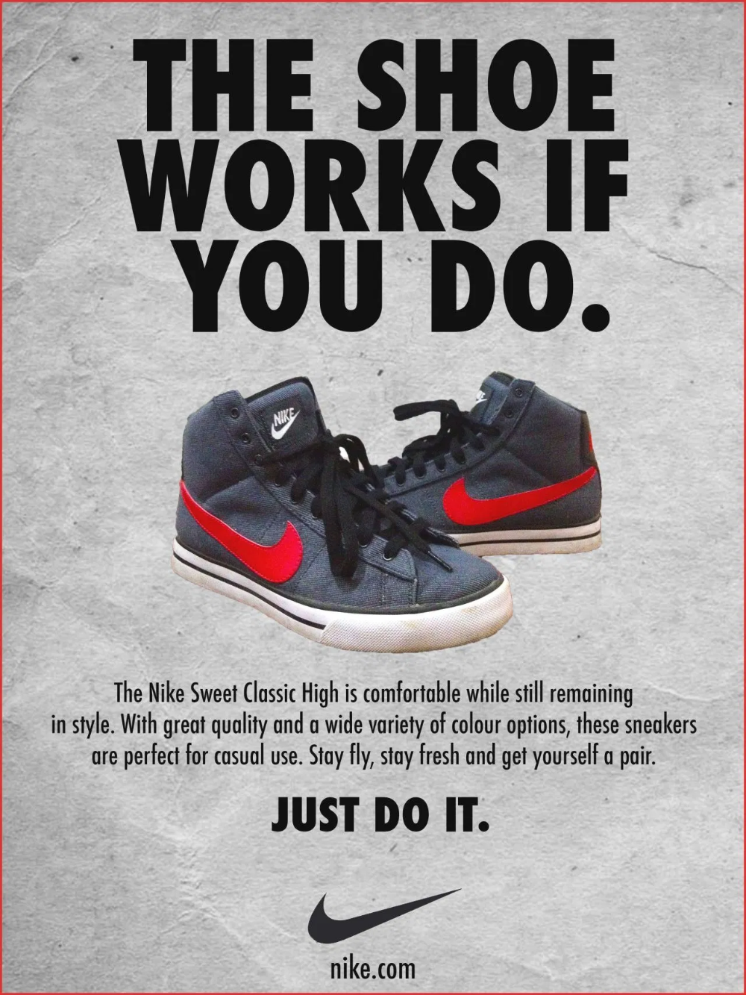
Exercise: Risk identification and mitigation
Ad-creator is a software that creates an ad based on product, its value and the target segment.
The ad consists of heading, description text and a picture.
This ad can then be published in newspapers.
You are an Angel investor. What prominent risks do you see & what mitigation approach would you suggest?
Answer:
Feasibility – Create PoC
Marketing risk – Sign up high profile pilot customers

Slide 20
Khata-book is a product that maintains the purchases you make at your local kirana (small grocery) store and you can make payment at the end of the month.
Target market is Kirana stores and customers (who will have to approve the purchase)
You are a product consultant. What prominent risks do you see & what mitigation approach would you suggest?
Answer:
Value risk – Speak to 50 kirana stores and 1000 customers to assess value
Usability risk – since users are kirana store owners & lay people. Do usability testing with sample users

Slide 21
Experience sharing…
How did you address the risks in your product solution?

Slide 22
Appendix

